Slide 1
Fundamentals of Bayesian Analysis with PyMC3 and TFP
TW: @charangostation
IG: @sebasarango118

Slide 2
About me

Slide 3



Lead Data Scientist @ Experimentality
MSc. (asp) in Software Engineering @ EAFIT
BSc. in Electronics Engineering @ UdeA

Slide 4
Introduction

Slide 5
Statistics & Probability in ML/DL?
Every ML model makes use of statistics.
Libraries and frameworks tend to mask its details.
Strong prior assumptions on data.

Slide 6
Do you use…?
Then you assume...
Naive Bayes
Linear Regression
Mean Squared Error
Pearson Correlation Coefficient
Variables to be statistically independent.
Error to be Gaussian distributed by default in many cases.
Homoscedasticity (variance remains constant and finite for assessment)
Linearity and Homoscedasticity.

Slide 7
Get to learn Statistics!
It might make the difference (or it might not)

Slide 8
Bayesian Analysis

Slide 9
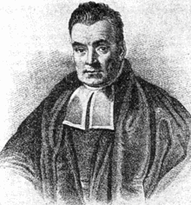
Bayesian Analysis
One approach to probabilistic modeling and inference.
Very close to human (natural) decision-making.
Allows to quantify uncertainty.
Cares about a priori assumptions (ML tools use them a lot).
Prior knowledge is modified by evidence.

Slide 10
Bayesian
Frequentist
More intuitive, less used though.
Parameters (𝚹) are unknown.
Evidence data (D) are known.
Posterior 𝒑(𝚹 | D) summarizes everything about 𝚹. MAP.
Credible Intervals (uncertainty relates to 𝚹).
Less intuitive.
Parameters (𝚹) are not RV.
Evidence data (D) are unknown.
Likelihood 𝒑(D | 𝚹) explains the evidence. MLE.
Confidence Intervals (uncertainty relates to interval itself).
Notes:
After this: why isn’t everyone a Bayesian?

Slide 11




Probability Rules
Prob. of Union
Joint prob.
Marginal prob.
Conditional prob.

Slide 12
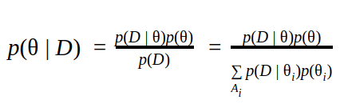
Bayes’ Theorem
Likelihood
Prior
Posterior
Normalizing factor
Notes:
Using the previous eqns...
Likelihood: frequentist
Posterior: Bayesian

Slide 13
Bayes’ Theorem
Bayesian → Posterior
Frequentist → Likelihood (misses prior beliefs)
Normalizing factor can be a sum (discrete) or an integral (continuous)
It is difficult sometimes to calculate it analytically →Computational methods
Notes:
Difficult bcz parameter (hypothesis) space can be very complex for analytical integration

Slide 14
Computational Methods
Variational Bayes Inference
Provides exact, analytical solutions
Locally optimal
Monte Carlo algorithms
Draw statistically independent samples (no autocorrelation)
Markov Chain Monte Carlo algorithms
Metropolis-Hastings → Gibbs Sampling | Hamiltonian MC ...
Notes:
MCMC includes autocorrelation, but controls its effect with CLT

Slide 15
Probabilistic Programming

Slide 16
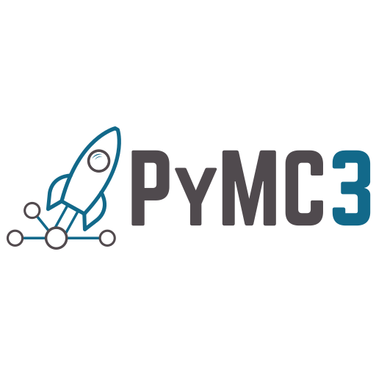

Probabilistic Programming
Tools for Python
PyMC3
TensorFlow Probability

Slide 17
TensorFlow Probability
Library for probabilistic reasoning and statistical analysis in TensorFlow.
Supports major TF features: Eager mode, HW acceleration, autodiff, vectorization...
Low-level blocks: Distributions | Bijectors
High-level blocks: MCMC | Probabilistic layers | Structural time series | Edward2

Slide 18
PyMC3
Library for probabilistic reasoning and statistical analysis over Theano.
Supports MCMC and Variational Bayes inference methods.
Easy-to-use Python user interface.
Defines models as Python context managers.

Slide 19
Example: Bayesian Linear Regression

Slide 20
Conclusions

Slide 21
Conclusions
Go Bayesian!
Simplicity: PyMC3 is designed to provide a more straightforward user experience than TFP.
Control: TFP is more open to tuning and modifications. Yet PyMC3 covers the common parameterization.
Support: TFP has a better community support (may be chaotic as well).
Computation: TFP relies on top features of TF.

Slide 22
Thank you!
TW: @charangostation
IG: @sebasarango118
EM: sebasarango1180@gmail.com

